Slide 1
Case Study Hack NSU 2.0

Slide 2
A website can be launched which will help to establish a MIS (Management Information System). The website should have the following key features:
Two types of accounts – Customer Account & Vendor Account.
Customer Account keeps track of all the orders and payments a customer has made.
Vendor Account has information related to the choice and stock of products, pricing, delivery details, transaction history for a particular vendor.

Slide 3
How is the procurement process automated?
Customer makes an order using the website.
Company A assesses the order and posts a ”Purchase Requirement” on the website which will be visible to the vendors.
Each vendor can make their bid to meet the Purchase Requirement
Company A selects the most lucrative bid.
The build-up of historical data over time will also allow predictive claims to be made up future customer demands.

Slide 4
What’s your smart approach to help the vendors in terms of Inventory Management, POS, Accounting side?
Simple and intuitive UI using which vendors can create and update information related to the products they hold, pricing and stock.
Tables and reports will be automatically generated which summarize the total inventory in stock and the history of sales
“One-Button-Press-Tool” to compare product they are selling against similar product sold by other vendors.
Prediction of rise or fall in demand for particular product using historical data.
When Company A posts a new Purchase Requirement, relevant vendors will receive automatic notification.

Slide 5
How do you think the communication system can be built among the vendors?
Each vendor will have a public version of their profiles which will be visible to all the other vendors.
Vendors can control what data they want to make public.
When an order is made to a vendor, vendors who are further downstream in the supply chain will be automatically notified. For example: if an order is made for a large number of packaging materials, the transportation vendor will be notified about a possible rise in demand for trucks very soon.

Slide 6
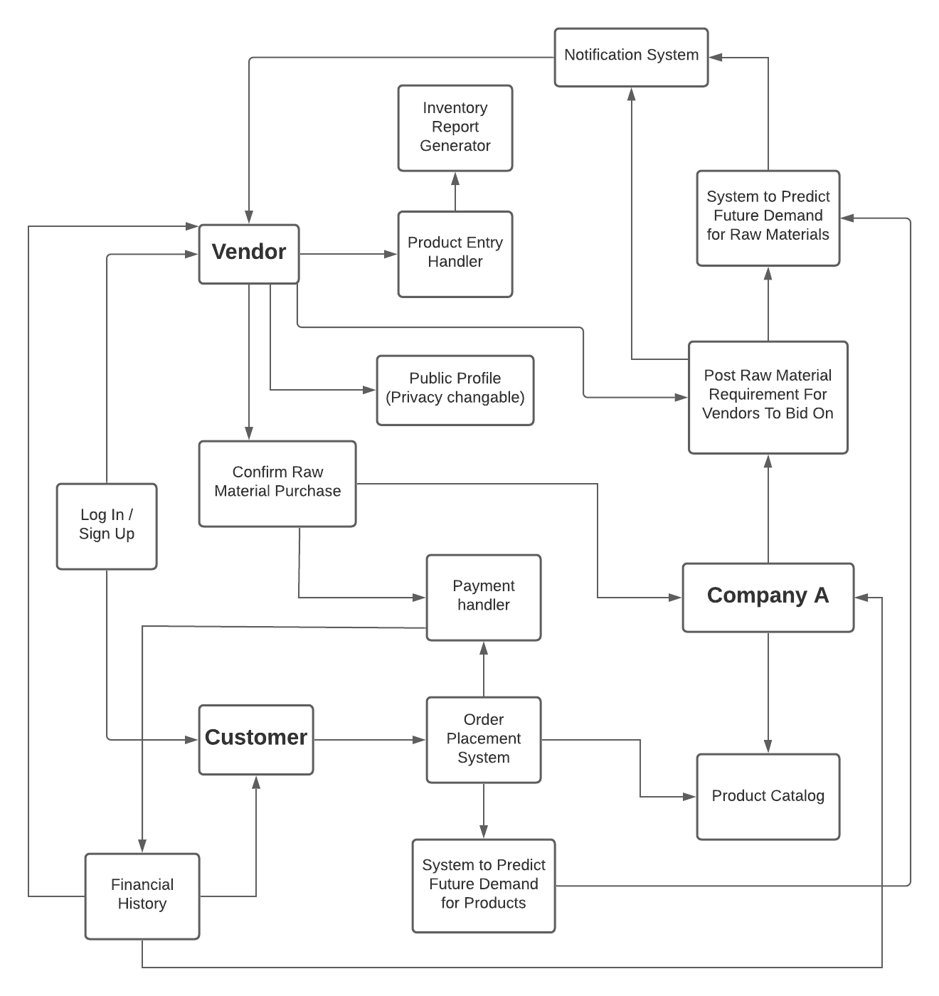
System Architecture:

Slide 7
Participants:
1. Sihat Afnan
2. Nazmul Takbir
3. Arif Shariar Rahman

